Slide 1
INFO-3142
Strings

Slide 2
Strings as Sequences of Characters
For the purposes of extracting characters and substrings, strings can be considered to be sequences of characters, which means that you can use index or slice notation:
x = "Hello"
print(x[0])
#'H'
print(x[-1])
#'o'

Slide 3
Strings as Sequences of Characters
print(x[1:])
#'ello'
x = "Goodbye\n"
x = x[:-1]
print(x)
#'Goodbye'
print(len("Goodbye"))
#7

Slide 4
Basic String Operations
x = "Hello " + "World"
print(x)
#'Hello World'
print(8 * "x")
#'xxxxxxxx'

Slide 5
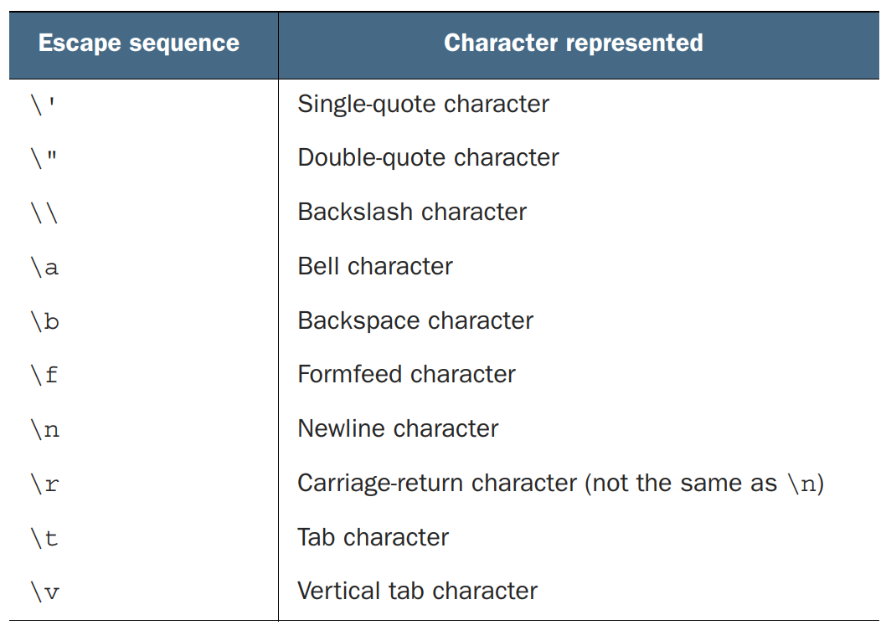
Special Characters and Escape Sequences

Slide 6
Special Characters and Escape Sequences
print('m')
#'m'
print('\155')
#'m'
print('\x6D')
#'m'

Slide 7
Special Characters and Escape Sequences
print('\n')
#'\n'
print('\012')
#'\n'
print('\x0A')
#'\n'

Slide 8
Special Characters and Escape Sequences
unicode_a = '\N{LATIN SMALL LETTER A}'
print(unicode_a)
#'a'
unicode_a_with_acute = '\N{LATIN SMALL LETTER A WITH ACUTE}'
print(unicode_a_with_acute)
#'á'
print("\u00E1")
#'á'

Slide 9
Printing vs Evaluating
#>>>'a\n\tb'
#'a\n\tb'
print('a\n\tb')
#a
# b
print("abc\n")
#abc
print("abc\n", end="")
#abc

Slide 10
string Methods
Most of the Python string methods are built into the standard Python string class, so all string objects have them automatically
The standard string module also contains some useful constants
Most string methods are attached to the string object they operate on by a dot (.), as in x.upper()
Because strings are immutable, the string methods are used only to obtain their return value and don’t modify the string object they’re attached to in any way

Slide 11
.split and .join string Methods
print(" ".join(["join", "puts", "spaces", "between", "elements"]))
#'join puts spaces between elements'
print("::".join(["Separated", "with", "colons"]))
#'Separated::with::colons'
print("".join(["Separated", "by", "nothing"]))
#'Separatedbynothing'
x = "You\t\t can have tabs\t\n \t and newlines \n\n mixed in"
print(x.split())
#['You', 'can', 'have', 'tabs', 'and', 'newlines', 'mixed', 'in']

Slide 12
.split and .join string Methods
x = "Mississippi"
print(x.split("ss"))
#['Mi', 'i', 'ippi']
x = 'a b c d'
print(x.split(' ', 1))
#['a', 'b c d']
print(x.split(' ', 2))
#['a', 'b', 'c d']
print(x.split(' ', 9))
#['a', 'b', 'c', 'd']

Slide 13
Converting strings to numbers
You can use the functions int and float to convert strings to integer or floating-point numbers, respectively
If they’re passed a string that can’t be interpreted as a number of the given type, these functions raise a ValueError exception

Slide 14
Converting strings to numbers
print(float('123.456'))
#123.456
#print(float('xxyy'))
#Traceback (innermost last):
# File "<stdin>", line 1, in ?
#ValueError: could not convert string to float: 'xxyy'

Slide 15
Converting strings to numbers
print(int('3333'))
#3333
#print(int('123.456'))
#Traceback (innermost last):
# File "<stdin>", line 1, in ?
#ValueError: invalid literal for int() with base 10: '123.456'
print(int('10000', 8))
#4096
print(int('101', 2))
#5

Slide 16
Converting strings to numbers
print(int('ff', 16))
#255
#print(int('123456', 6))
#Traceback (innermost last):
# File "<stdin>", line 1, in ?
#ValueError: invalid literal for int() with base 6: '123456'

Slide 17
Getting Rid of Extra White Space
x = " Hello, World\t\t "
print(x.strip())
#'Hello, World'
print(x.lstrip())
#'Hello, World\t\t '
print(x.rstrip())
#' Hello, World'
import string
print(string.whitespace)
#' \t\n\r\x0b\x0c'
#" \t\n\r\v\f"
#' \t\n\r\x0b\x0c'

Slide 18
Getting Rid of Extra White Space
x = "www.python.org"
print(x.strip("w"))
#'.python.org'
print(x.strip("gor"))
#'www.python.'
print(x.strip(".gorw"))
#'python'

Slide 19
String Searching
The four basic string-searching methods are similar: find, rfind, index, and rindex
A related method, count, counts how many times a substring can be found in another string
x = "Mississippi"
print(x.find("ss"))
#2
print(x.find("zz"))
#-1
x = "Mississippi"
print(x.find("ss", 3))
#5

Slide 20
String Searching
print(x.find("ss", 0, 3))
#-1
x = "Mississippi"
print(x.rfind("ss"))
#5
x = "Mississippi"
print(x.count("ss"))
#2

Slide 21
String Searching
x = "Mississippi"
print(x.startswith("Miss"))
#True
print(x.startswith("Mist"))
#False
print(x.endswith("pi"))
#True
print(x.endswith("p"))
#False
print(x.endswith(("i", "u")))
#True

Slide 22
Modifying Strings
Strings are immutable, but string objects have several methods that can operate on that string and return a new string that’s a modified version of the original string.
This provides much the same effect as direct modification for most purposes
x = "Mississippi"
print(x.replace("ss", "+++"))
#'Mi+++i+++ippi'
x = "~x ^ (y % z)"
table = x.maketrans("~^()", "!&[]")
print(x.translate(table))
#'!x & [y % z]'

Slide 23
Modifying Strings with List Manipulations
Because strings are immutable objects, you have no way to manipulate them directly in the same way that you can manipulate lists
Although the operations that produce new strings (leaving the original strings unchanged) are useful for many things, sometimes you want to be able to manipulate a string as though it were a list of characters
text = "Hello, World"
wordList = list(text)
wordList[6:] = []
wordList.reverse()
text = "".join(wordList)
print(text)
#,olleH

Slide 24
Useful Methods and Constants
Because strings are immutable objects, you have no way to manipulate them directly in the same way that you can manipulate lists
Although the operations that produce new strings (leaving the original strings unchanged) are useful for many things, sometimes you want to be able to manipulate a string as though it were a list of characters

Slide 25
Useful Methods and Constants
x = "123"
print(x.isdigit())
#True
print(x.isalpha())
#False
x = "M"
print(x.islower())
#False
print(x.isupper())
#True

Slide 26
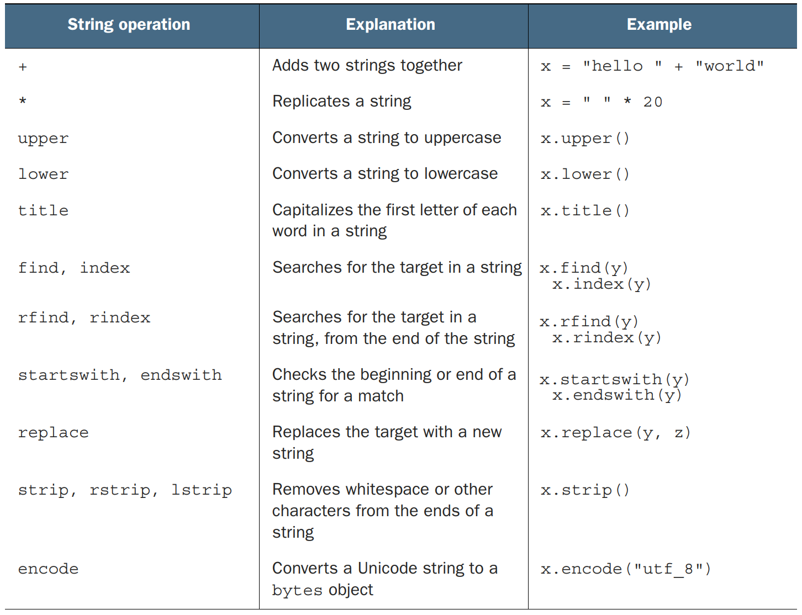
Useful Methods

Slide 27
Converting from Objects to Strings
In Python, almost anything can be converted to some sort of a string representation by using the built-in repr function
print(repr([1, 2, 3]))
#'[1, 2, 3]'
x = [1]
x.append(2)
x.append([3, 4])
print('the list x is ' + repr(x))
#'the list x is [1, 2, [3, 4]]'

Slide 28
The format Method
print("{0} is the {1} of {2}".format("Ambrosia", "food", "the gods"))
#'Ambrosia is the food of the gods'
print("{{Ambrosia}} is the {0} of {1}".format("food", "the gods"))
#'{Ambrosia} is the food of the gods'
# format method, named params
print("{food} is the food of {user}".format(food="Ambrosia", user="the gods"))
#'Ambrosia is the food of the gods'
print("{0} is the food of {user[1]}".format("Ambrosia", user=["men", "the gods", "others"]))
#'Ambrosia is the food of the gods'

Slide 29
format Specifiers
print("{0:10} is the food of gods".format("Ambrosia"))
#'Ambrosia is the food of gods'
print("{0:{1}} is the food of gods".format("Ambrosia", 10))
#'Ambrosia is the food of gods'
print("{food:{width}} is the food of gods".format(food="Ambrosia", width=10))
#'Ambrosia is the food of gods'
print("{0:>10} is the food of gods".format("Ambrosia"))
#' Ambrosia is the food of gods'
print("{0:&>10} is the food of gods".format("Ambrosia"))
#'&&Ambrosia is the food of gods'

Slide 30
Formatting Strings with %
print("%s is the %s of %s" % ("Ambrosia", "food", "the gods"))
#'Ambrosia is the food of the gods'
print("%s is the %s of %s" % ("Nectar", "drink", "gods"))
#'Nectar is the drink of gods'
print("%s is the %s of the %s" % ("Brussels Sprouts", "food", "foolish"))
#'Brussels Sprouts is the food of the foolish'
x = [1, 2, "three"]
print("The %s contains: %s" % ("list", x))
#"The list contains: [1, 2, 'three']"

Slide 31
Formatting Sequences
print("Pi is <%-6.2f>" % 3.14159) # use of the formatting sequence: %–6.2f
#'Pi is <3.14 >'
# Named params and Formatting sequences
num_dict = {'e': 2.718, 'pi': 3.14159}
print("%(pi).2f - %(pi).4f - %(e).2f" % num_dict)
#3.14 - 3.1416 - 2.72

Slide 32
String Interpolation
String interpolation is a way to include the values of Python expressions inside literal strings
These f-strings, as they’re commonly called because they are prefixed with f, use a syntax similar to that of the format method, but with a little less overhead
value = 42
message = f"The answer is {value}"
print(message)
#The answer is 42
pi = 3.1415
print(f"pi is {pi:{10}.{2}}")
#pi is 3.1

Slide 33
Bytes
A bytes object is similar to a string object but with an important difference: A string is an immutable sequence of Unicode characters, whereas a bytes object is a sequence of integers with values from 0 to 256
Bytes can be necessary when you’re dealing with binary data, such as reading from a binary data file unicode_a_with_acute = '\N{LATIN SMALL LETTER A WITH ACUTE}'
print(unicode_a_with_acute)
#'á'
xb = unicode_a_with_acute.encode()
print(xb)
#b'\xc3\xa1'

Slide 34
Bytes
#xb += 'A'
#Traceback (most recent call last):
# File "<pyshell#35>", line 1, in <module>
# xb += 'A'
#TypeError: can't concat str to bytes
print(xb.decode())
#'á'

